Slide 1
Basel II.5, Basel III, and Other Post-Crisis Changes
Chapter 26

Slide 2
Basel II.5 (Implemented Dec 31, 2011)
Stressed VaR for market risk
  Calculated over one year period of stressed market conditions
  Capital = max(VaR_{t-1},m_{c} × VaR_{avg})
  +max(sVaR_{t-1}, m_{s} × sVaR_{avg})
Incremental Risk Charge
  Ensures that products such as bonds and credit derivatives in the trading book have the same capital requirement that they would if they were in the banking book

Slide 3
Basel II.5 continued
Comprehensive Risk Measure
  Designed to make sure sufficient capital is kept for instruments in the trading book that depend on on credit default correlations
  Standard approach:
Credit Rating | AAA or AA | A | BBB | BB | Below BB
Securitizations | 1.6% | 4% | 8% | 28% | Deduction
Resecuritizations | 3.2% | 8% | 18% | 52% | Deduction

Slide 4
Basel III (Section 26.2)
Capital Definition and Requirements
Capital Conservation Buffer
Countercyclical Buffer
Leverage Ratio
Liquidity Ratios
Capital for CVA Risk
Full implementation in 2022

Slide 5
Capital Definition and Requirements
  Three types:
  Common equity Tier 1
  Additional Tier 1
  Tier 2
  Definitions tightened
  Limits
  Common equity > 4.5% of RWA
  Tier 1 > 6% of RWA
  Tier 1 plus Tier 2 > 8% of RWA

Slide 6
Capital Conservation Buffer (Section 26.2.2)
Extra 2.5% of common equity required in normal times to absorb losses in periods of stress
If total common equity is less than 7% (=4.5%+2.5%) dividends are restricted

Slide 7
Countercyclical Buffer
Extra equity capital to allow for cyclicality of bank earnings
Left to the discretion of national regulators
Can be as high as 2.5% of RWA
Dividends restricted when capital is below required level

Slide 8
Leverage Ratio (Section 26.2.4)
Ratio of Tier 1 capital to total exposure (not risk weighted) must be greater than 3% (Higher in U.S., U.K., and China)
Exposure includes all items on balance sheet, derivatives exposures (calculated as in Basel I), securities financing exposures, and some off-balance sheet items

Slide 9
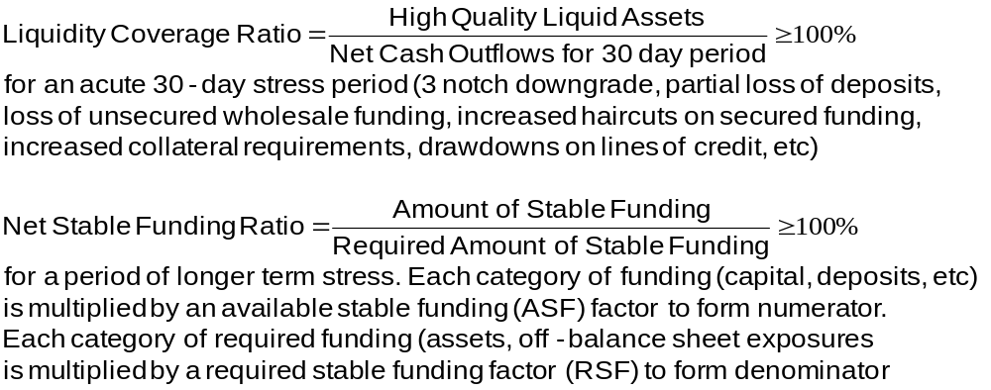
Liquidity Risk Ratios (Section 26.2.5)

Slide 10
ASF Factors (Table 26.4)
ASF Factor | Category
100% | Tier 1 and Tier 2 capital Preferred stock and borrowing with a remaining maturity greater than 1 year
90% | Stable demand deposits and term deposits
80% | Les stable demand deposits and term deposits
50% | Wholesale demand deposits
0% | All other liability and equity categories

Slide 11
RSF Factors (Table 26.5)
RSF Factor | Category
0% | Cash and short-term instruments (<1 yr)
5% | Claims on sovereign governments with a risk weight =0% (>1 yr)
20% | Corporate bonds rating AA or higher (>1 yr) Claims on sovereigns with risk weight =20%
50% | Gold, equities, and bond rated A
65% | Residential mortgages
85% | Loans to retail and small business (<1 year)
100% | All other assets

Slide 12
Capital for CVA Risk
CVA is the adjustment to the value of transactions with a counterparty to allow for the possibility of a counterparty default
Basel III requires market risk capital for CVA risk arising from changing credit spreads

Slide 13
G-SIBs
G-SIBs are Global Systemically Important Banks
These are required to hold extra Tier 1 equity capital between 1% and 3.5% of risk-weighted assets
For banks in the 2.5% category Tier 1 equity capital is the basic 4.5% plus the 2.5% capital conservation buffer plus 2.5% for being G-SIBs plus any extra required from national regulator.
There are also proposals from the FSB and Basel Committee concerning the total loss absorbing capacity (TLAC) of G-SIBs. This consists of all instruments that protect depositors (including subordinated long term debt)

Slide 14
D-SIBs
D-SIBs are domestic systemically important banks.
These banks may be subject to additional capital, extra disclosure, and stress tests.
In the United States, banks with assets over $50 billion are classified as D-SIBs.

Slide 15
Contingent Convertible Bonds
Bonds which automatically get converted into equity if certain conditions are satisfied
In Credit Suisse issue (See Business Snapshot 26.1) there is conversion if
  Tier 1 equity falls below 7% of RWA, or
  Swiss regulator determines that the bank needs public sector support

Slide 16
SA-CCR
New rule for calculating exposure at default EAD under the standardized approach
EAD = 1.4×(RC+PFE)
where RC is replacement cost and PFE is potential future exposure
When no collateral is posted RC=max(V,0) where V is the value to the bank
Else RC=max(V-C,D,0) where C is current collateral and D is amount that V can increase without further collateral being transferred

Slide 17
SA-CCR continued
PFE is a more sophisticated way of calculating the Basel I “add-on amount”. For example it incorporates the following:
  when no collateral is posted, risk reduces as V becomes more negative
  if V>0 and the counterparty has posted more collateral than V, risk is reduced as the excess collateral increases

Slide 18
Dodd-Frank includes…
New bodies to monitor systemic risk (FSOC and OFR)
Volcker rule
Central clearing for OTC derivatives
Living wills
More capital for SIFIs
No use of external ratings
Oversight of rating agencies
Originators of asset backed securities must keep “skin in the game”
Separately capitalized affiliates for more risky business
All trades reported to a central agency
…

Slide 19
Rules in Other Countries
UK: Committee under Sir John Vickers led to Financial Services (Banking Reform Act) in 2013
In European Union committee headed by Erkki Liikanen proposed new regulations in 2012.

Slide 20
Key issues all regulators are attempting to address
Central clearing
Use of electronic platforms to trade
Restrict proprietary trading (or at least insulate it from other activities)
Living wills
Compensation (less restrictions in U.S.)

